Slide 1

DESIGN AND ANALYSIS OF ALGORITHMS (113939)
Dr. Owais Hussain

Slide 2

Agenda
Quicksort Pseudocode
Quicksort Piece by Piece
Complexity Analysis
Complexity Analysis – Worst case
Complexity Analysis – Best case
Complexity Analysis – Average case

Slide 3
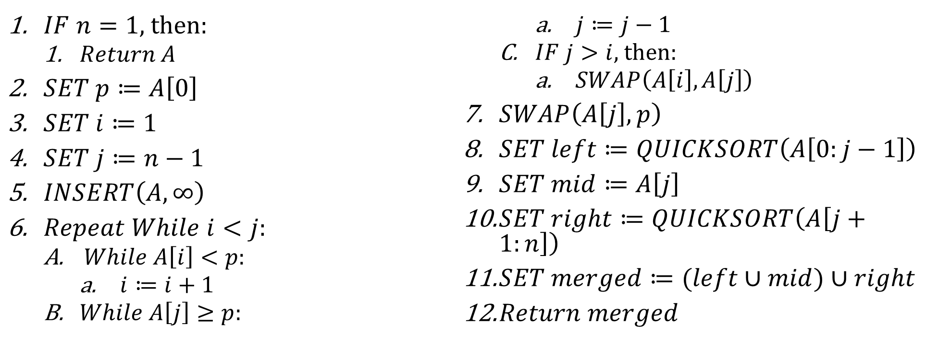
Sample 2
Quicksort Pseudocode
QUICKSORT(A, n) sorts array ‘A’ of size ‘n’ using Quicksort.
$IF n=1$, then:
$Return A$
$SET p≔A\left[0\right]$
$SET i≔1$
$SET j≔n−1$
$INSERT\left(A, ∞\right)$
$Repeat While i<j$:
$While A\left[i\right]<p$:
$i≔i+1$
$While A\left[j\right]≥p$:
$j≔j−1$
$IF j>i$, then:
$SWAP\left(A\left[i\right],A\left[j\right]\right)$
$SWAP\left(A\left[j\right],p\right)$
$SET left≔QUICKSORT\left(A\left[0:j−1\right]\right)$
$SET mid≔A\left[j\right]$
$SET right≔QUICKSORT\left(A\left[j+1:n\right]\right)$
$SET merged≔(left∪mid)∪right$
$Return merged$

Slide 4
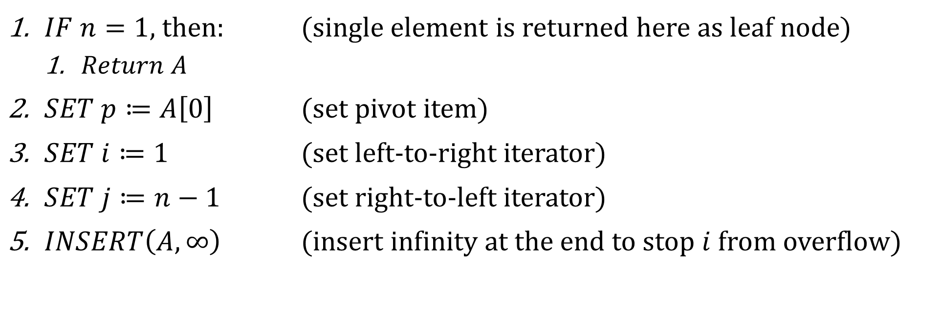
Sample 2
Quicksort Pseudocode – Piece by Piece
QUICKSORT(A, n) sorts array ‘A’ of size ‘n’ using Quicksort algorithm.
$IF n=1$, then: (single element is returned here as leaf node)
$Return A$
$SET p≔A\left[0\right]$ (set pivot item)
$SET i≔1$ (set left-to-right iterator)
$SET j≔n−1$ (set right-to-left iterator)
$INSERT\left(A, ∞\right)$ (insert infinity at the end to stop $i$ from overflow)

Slide 5
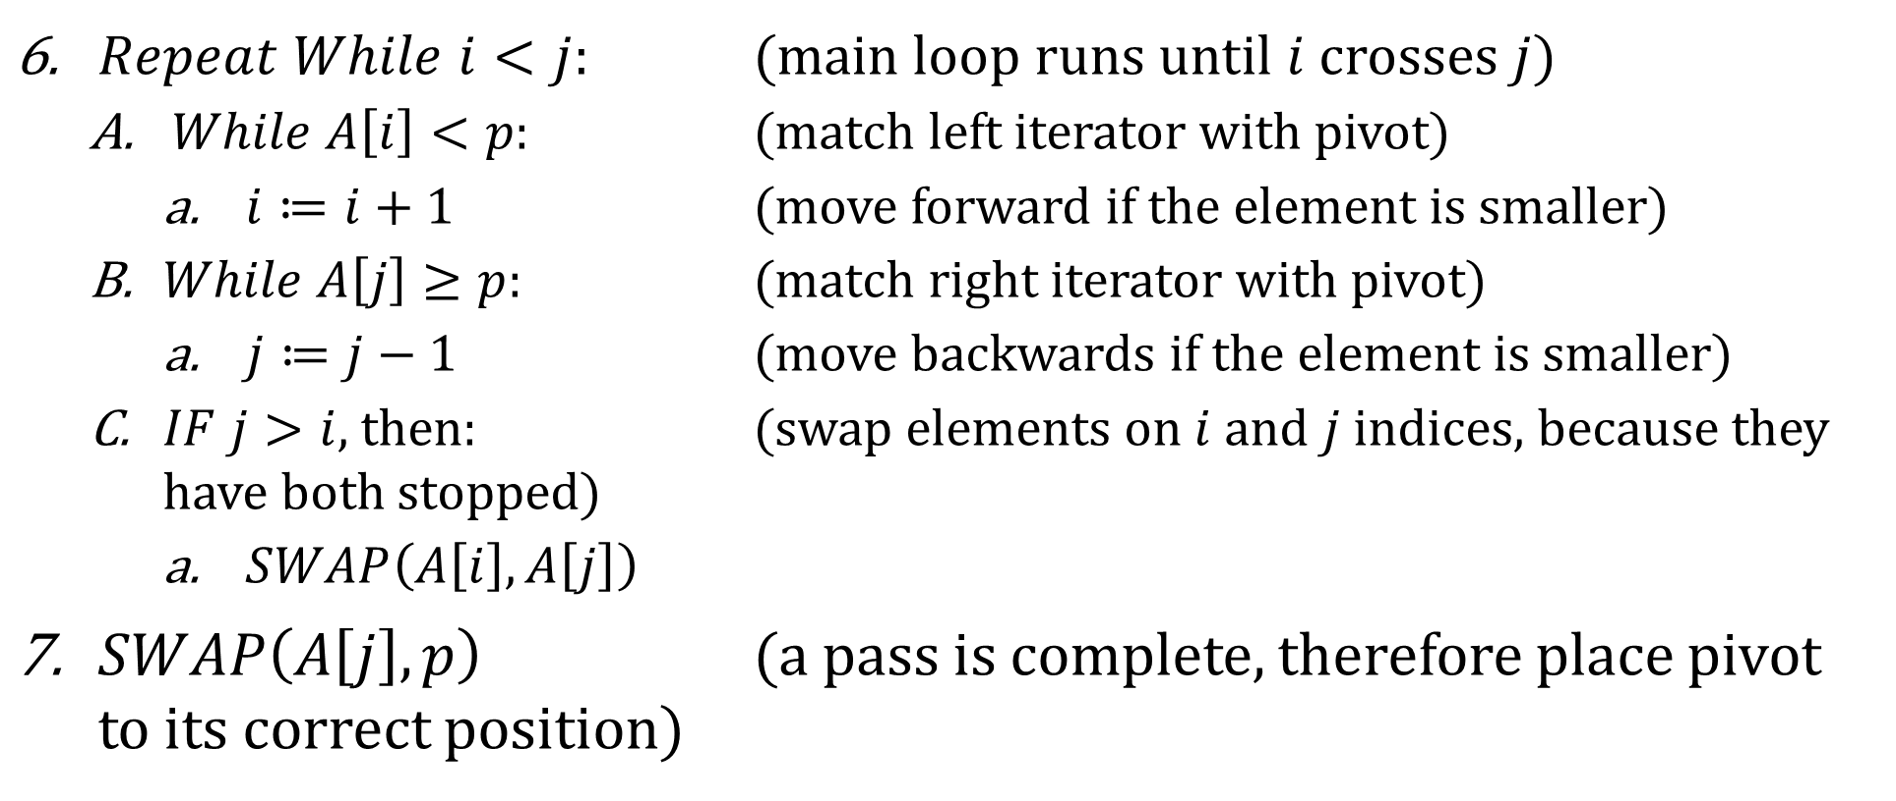
Sample 2
Quicksort Pseudocode – Piece by Piece
$Repeat While i<j$: (main loop runs until $i$ crosses $j$)
$While A\left[i\right]<p$: (match left iterator with pivot)
$i≔i+1$ (move forward if the element is smaller)
$While A\left[j\right]≥p$: (match right iterator with pivot)
$j≔j−1$ (move backwards if the element is smaller)
$IF j>i$, then: (swap elements on $i$ and $j$ indices, because they have both stopped)
$SWAP\left(A\left[i\right],A\left[j\right]\right)$
$SWAP\left(A\left[j\right],p\right)$ (a pass is complete, therefore place pivot to its correct position)

Slide 6
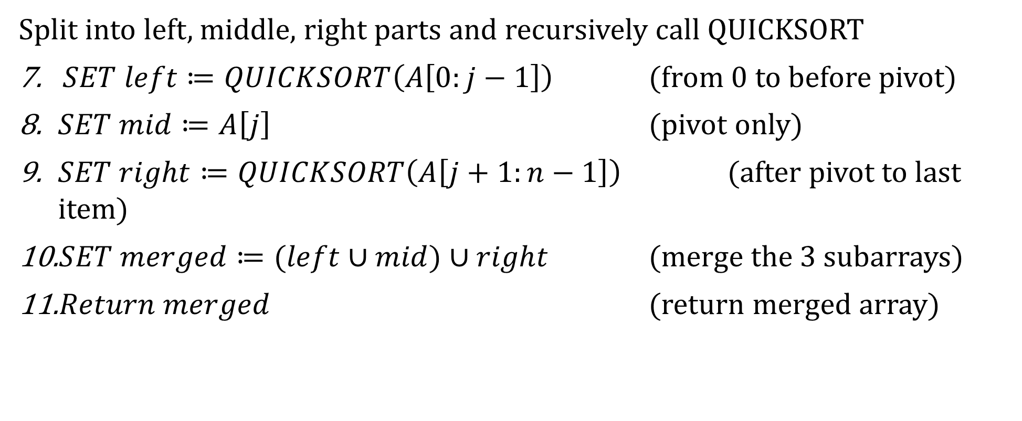
Sample 2
Quicksort Pseudocode – Piece by Piece
Split into left, middle, right parts and recursively call QUICKSORT
$SET left≔QUICKSORT\left(A\left[0:j−1\right]\right)$ (from 0 to before pivot)
$SET mid≔A\left[j\right]$ (pivot only)
$SET right≔QUICKSORT\left(A\left[j+1:n−1\right]\right)$ (after pivot to last item)
$SET merged≔(left∪mid)∪right$ (merge the 3 subarrays)
$Return merged$ (return merged array)

Slide 7
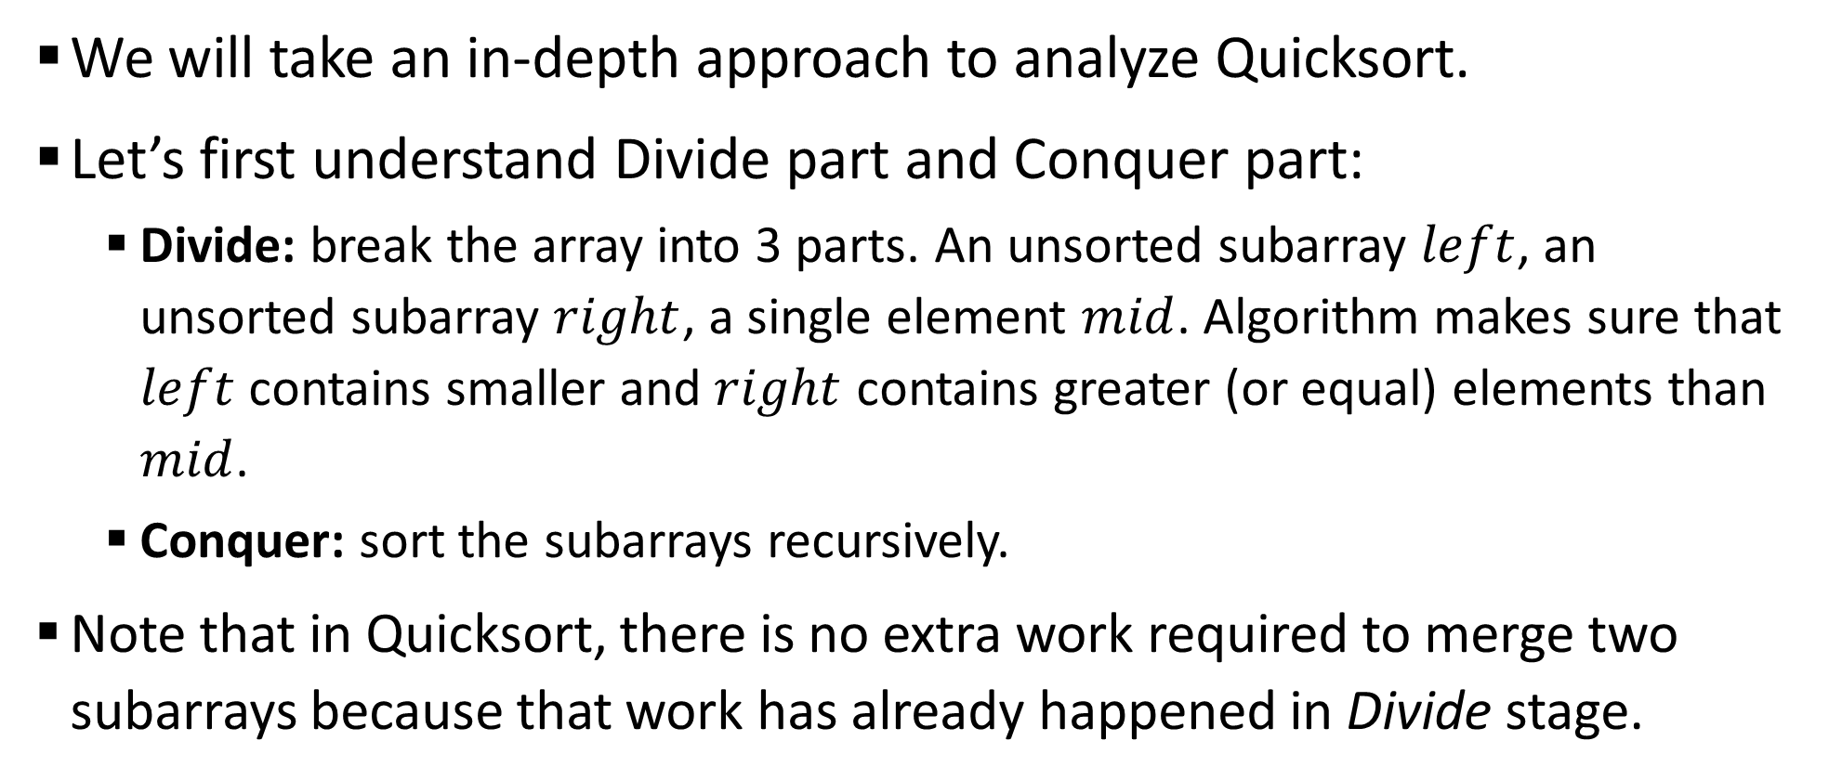
Sample 2
Complexity Analysis
We will take an in-depth approach to analyze Quicksort.
Let’s first understand Divide part and Conquer part:
Divide: break the array into 3 parts. An unsorted subarray $left$, an unsorted subarray $right$, a single element $mid$. Algorithm makes sure that $left$ contains smaller and $right$ contains greater (or equal) elements than $mid$.
Conquer: sort the subarrays recursively.
Note that in Quicksort, there is no extra work required to merge two subarrays because that work has already happened in Divide stage.

Slide 8
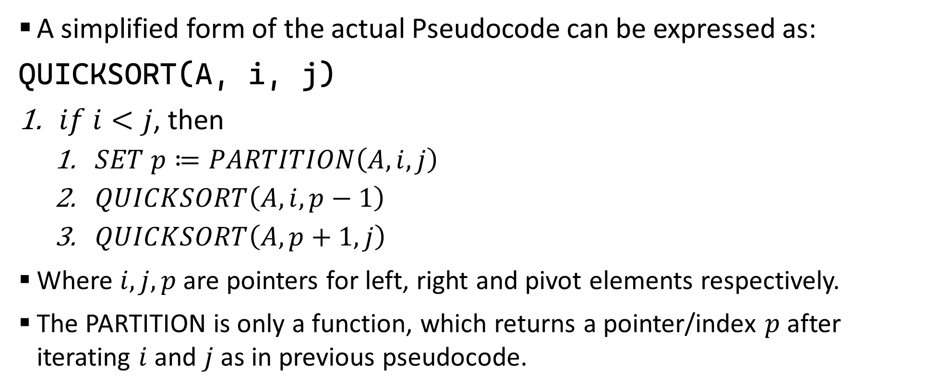
Sample 2
Complexity Analysis
A simplified form of the actual Pseudocode can be expressed as:
QUICKSORT(A, i, j)
$if i<j$, then
$SET p≔PARTITION\left(A, i, j\right)$
$QUICKSORT\left(A, i,p−1\right)$
$QUICKSORT\left(A,p+1,j\right)$
Where $i,j,p$ are pointers for left, right and pivot elements respectively.
The PARTITION is only a function, which returns a pointer/index $p$ after iterating $i$ and $j$ as in previous pseudocode.

Slide 9
Sample 2
Complexity Analysis
Focus on how recursion takes place. QUICKSORT is called recursively twice. Once for the left subarray and one for the right.
If we’re quick to jump to conclusion, this looks like Merge sort. However, in Merge sort, the partitions are equally divided. Does the same happen here?
What happens if the pivot is?:
Median value
Smallest value
Largest value

Slide 10
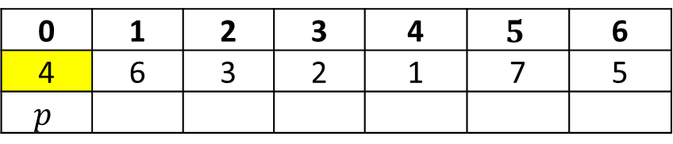
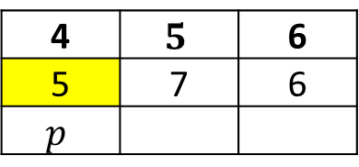
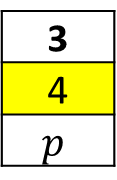
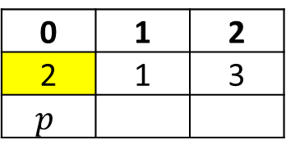
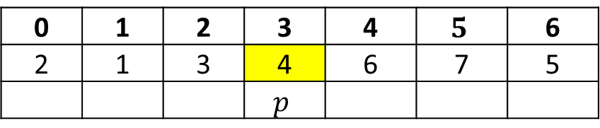
Sample 2
Complexity Analysis
Assume an array of size 7 with values 1-7.
When pivot is median value…
The partition will form a subtree with equal sized left and right subarrays.
In the 2nd pass also, the tree will be balanced.
This is an ideal Divide, and the best-case scenario.
0 | 1 | 2 | 3 | 4 | $$5$$ | 6
4 | 6 | 3 | 2 | 1 | 7 | 5
$$p$$
0 | 1 | 2 | 3 | 4 | $$5$$ | 6
2 | 1 | 3 | 4 | 6 | 7 | 5
 |  |  | $$p$$
3
4
$$p$$
0 | 1 | 2
2 | 1 | 3
$$p$$
4 | $$5$$ | 6
5 | 7 | 6
$$p$$

Slide 11

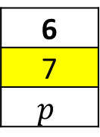
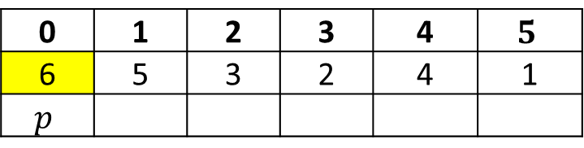
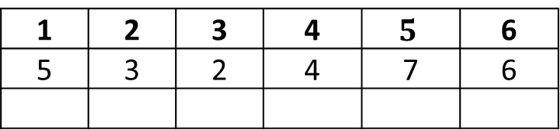
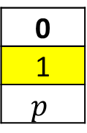
Sample 2
Complexity Analysis
When pivot is smallest value…
The partition will form an unbalanced tree with all remaining elements on right side.
The Divide strategy is failing in this case.
Same happens if the pivot is the largest value.
0 | 1 | 2 | 3 | 4 | $$5$$ | 6
1 | 5 | 3 | 2 | 4 | 7 | 6
$$p$$
0
1
$$p$$
1 | 2 | 3 | 4 | $$5$$ | 6
5 | 3 | 2 | 4 | 7 | 6
6
7
$$p$$
0 | 1 | 2 | 3 | 4 | $$5$$
6 | 5 | 3 | 2 | 4 | 1
$$p$$

Slide 12
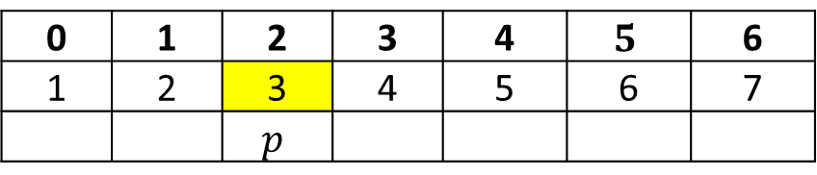

Sample 2
Complexity Analysis
In fact, (ironically) the worst-case scenario of Quicksort is when the data is already sorted in either ascending or descending order.
Solution? Choose a random value as pivot and swap it with first index.
There is still a possibility to randomly select smallest or largest element accidentally, but this happens rarely.
0 | 1 | 2 | 3 | 4 | $$5$$ | 6
1 | 2 | 3 | 4 | 5 | 6 | 7
 |  | $$p$$
0 | 1 | 2 | 3 | 4 | $$5$$ | 6
3 | 2 | 1 | 4 | 5 | 6 | 7
$$p$$

Slide 13
Sample 2
Complexity Analysis
For analysis of time complexity, we have 3 cases:
Worst case: the array is already sorted, therefore pivot tree falls towards one side.
Average case: the array is semi-sorted, therefore pivot tree is a semi-balanced tree.
Best case: the array is in such an order that the median values are always in the middle of subarrays, therefore the pivot tree forms a balanced binary tree.

Slide 14
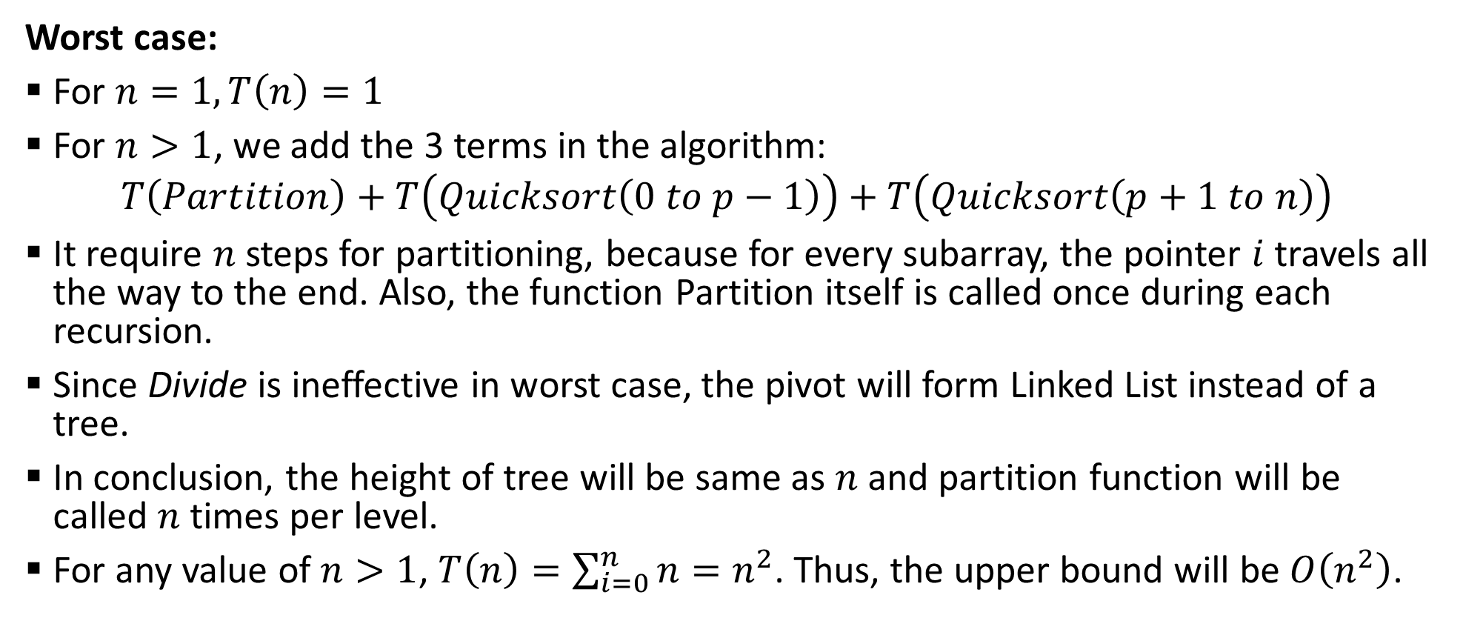
Sample 2
Complexity Analysis – Worst case
Worst case:
For $n=1, T\left(n\right)=1$
For $n>1$, we add the 3 terms in the algorithm:
$$T\left(Partition\right)+T\left(Quicksort\left(0 to p−1\right)\right)+T\left(Quicksort\left(p+1 to n\right)\right)$$
It require $n$ steps for partitioning, because for every subarray, the pointer $i$ travels all the way to the end. Also, the function Partition itself is called once during each recursion.
Since Divide is ineffective in worst case, the pivot will form Linked List instead of a tree.
In conclusion, the height of tree will be same as $n$ and partition function will be called $n$ times per level.
For any value of $n>1$, $T\left(n\right)=\sum_{i=0}^{n}{n}=n^{2}$. Thus, the upper bound will be $O\left(n^{2}\right)$.

Slide 15
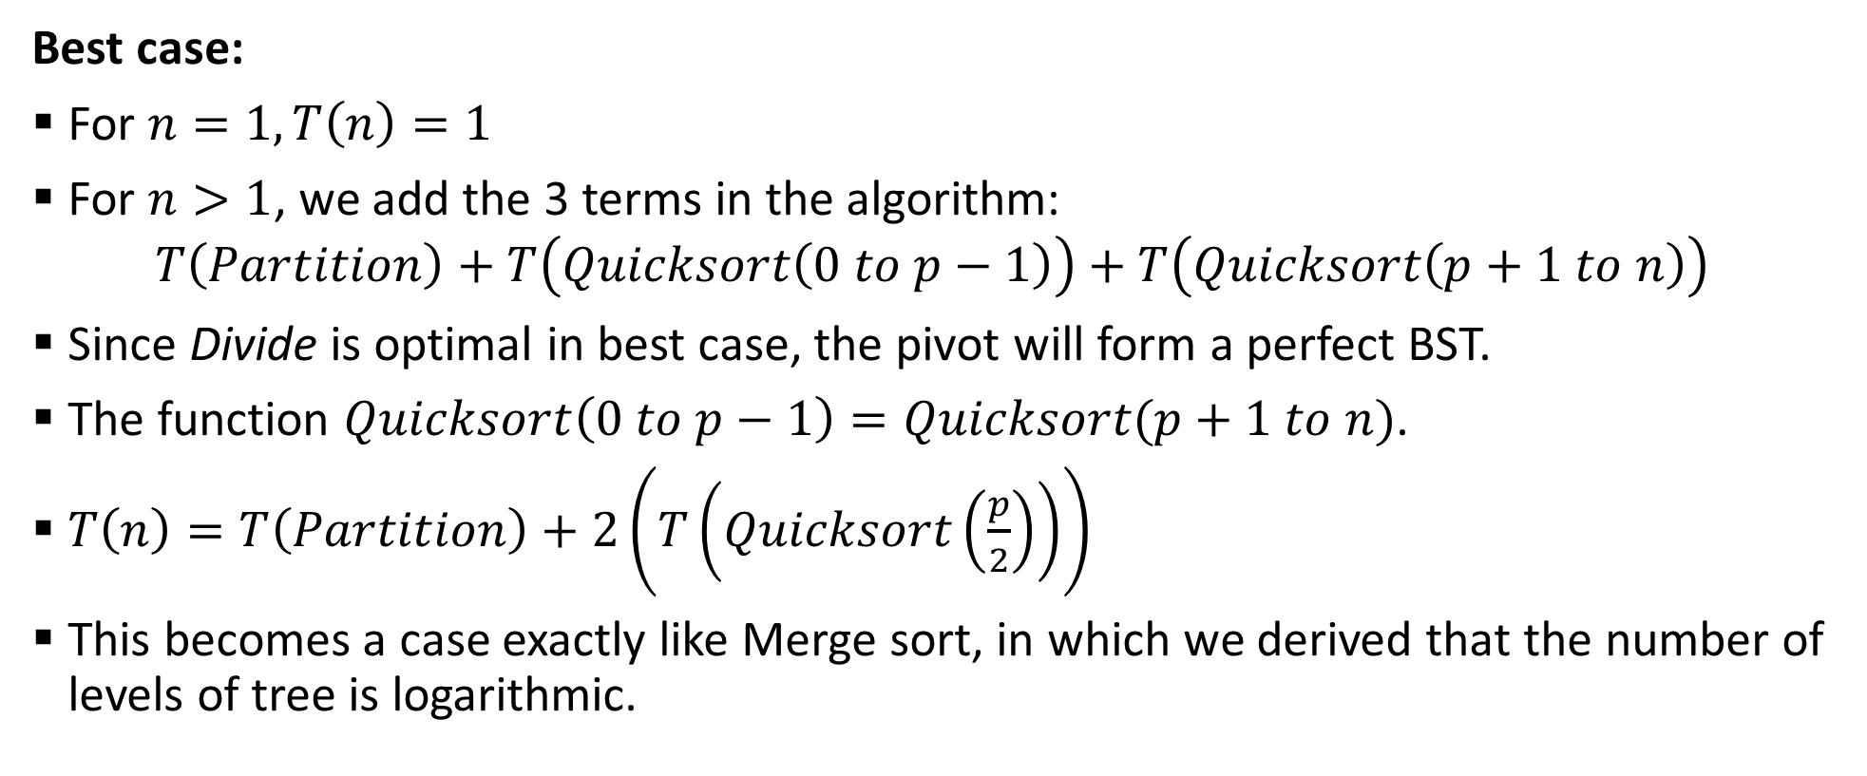
Sample 2
Complexity Analysis – Best case
Best case:
For $n=1, T\left(n\right)=1$
For $n>1$, we add the 3 terms in the algorithm:
$$T\left(Partition\right)+T\left(Quicksort\left(0 to p−1\right)\right)+T\left(Quicksort\left(p+1 to n\right)\right)$$
Since Divide is optimal in best case, the pivot will form a perfect BST.
The function $Quicksort\left(0 to p−1\right)=Quicksort(p+1 to n)$.
$T\left(n\right)=T\left(Partition\right)+2\left(T\left(Quicksort\left(\frac{p}{2}\right)\right)\right)$
This becomes a case exactly like Merge sort, in which we derived that the number of levels of tree is logarithmic.

Slide 16
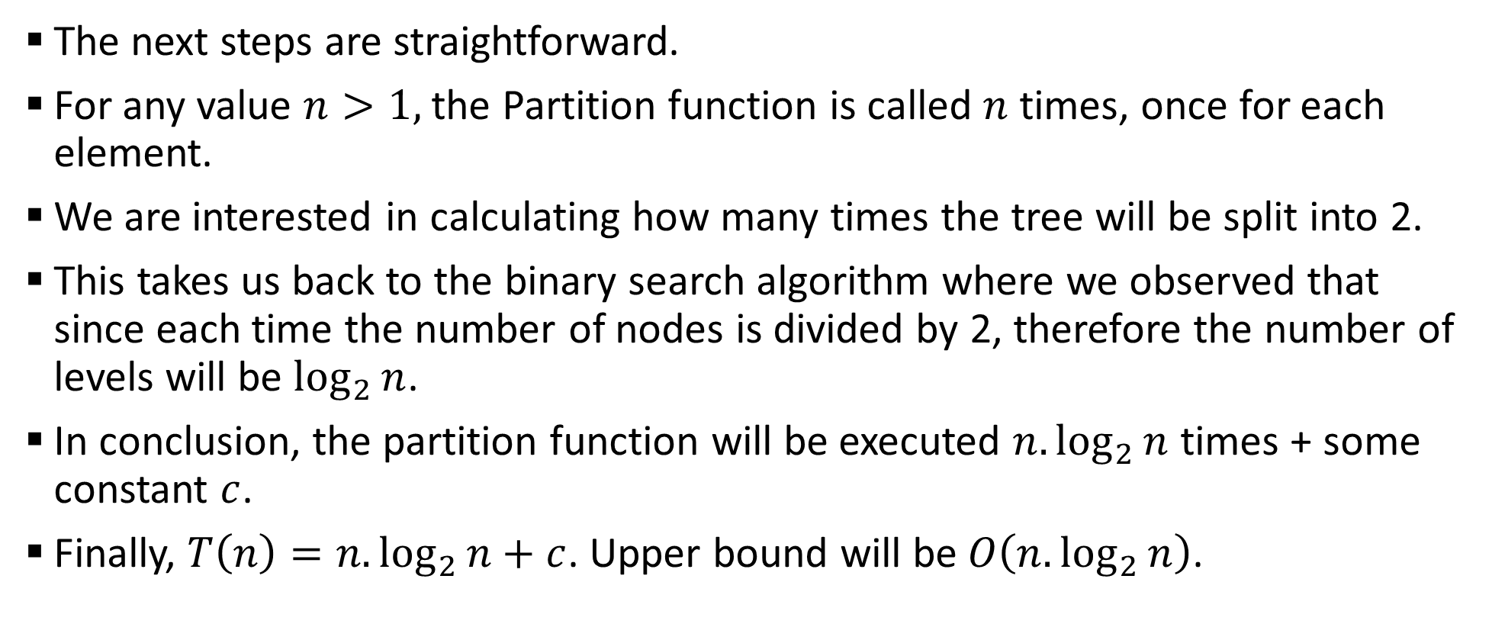
Sample 2
Complexity Analysis – Best case
The next steps are straightforward.
For any value $n>1,$ the Partition function is called $n$ times, once for each element.
We are interested in calculating how many times the tree will be split into 2.
This takes us back to the binary search algorithm where we observed that since each time the number of nodes is divided by 2, therefore the number of levels will be $\log_{2}{n}$.
In conclusion, the partition function will be executed $n.\log_{2}{n}$ times + some constant $c$.
Finally, $T\left(n\right)=n.\log_{2}{n}+c$. Upper bound will be $O\left(n.\log_{2}{n}\right)$.

Slide 17
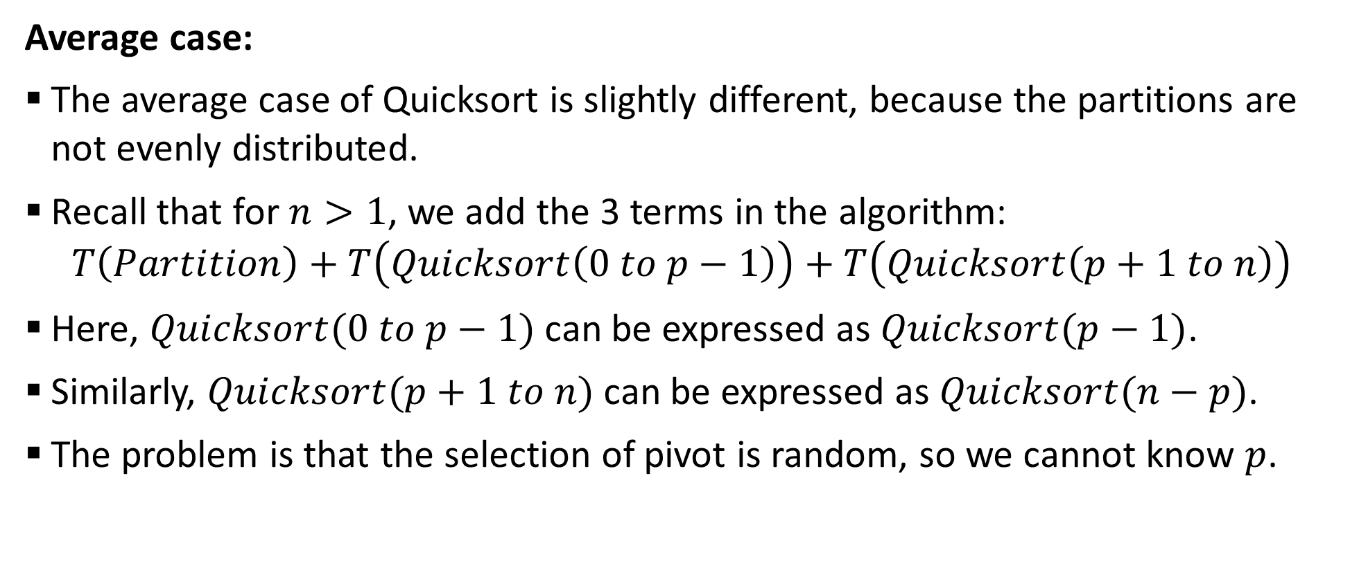
Sample 2
Complexity Analysis – Average case
Average case:
The average case of Quicksort is slightly different, because the partitions are not evenly distributed.
Recall that for $n>1$, we add the 3 terms in the algorithm:
$$T\left(Partition\right)+T\left(Quicksort\left(0 to p−1\right)\right)+T\left(Quicksort\left(p+1 to n\right)\right)$$
Here, $Quicksort(0 to p−1)$ can be expressed as $Quicksort(p−1)$.
Similarly, $Quicksort(p+1 to n)$ can be expressed as $Quicksort(n−p)$.
The problem is that the selection of pivot is random, so we cannot know $p$.
Notes:
Ref: CS502_Lecture14 - YouTube

Slide 18
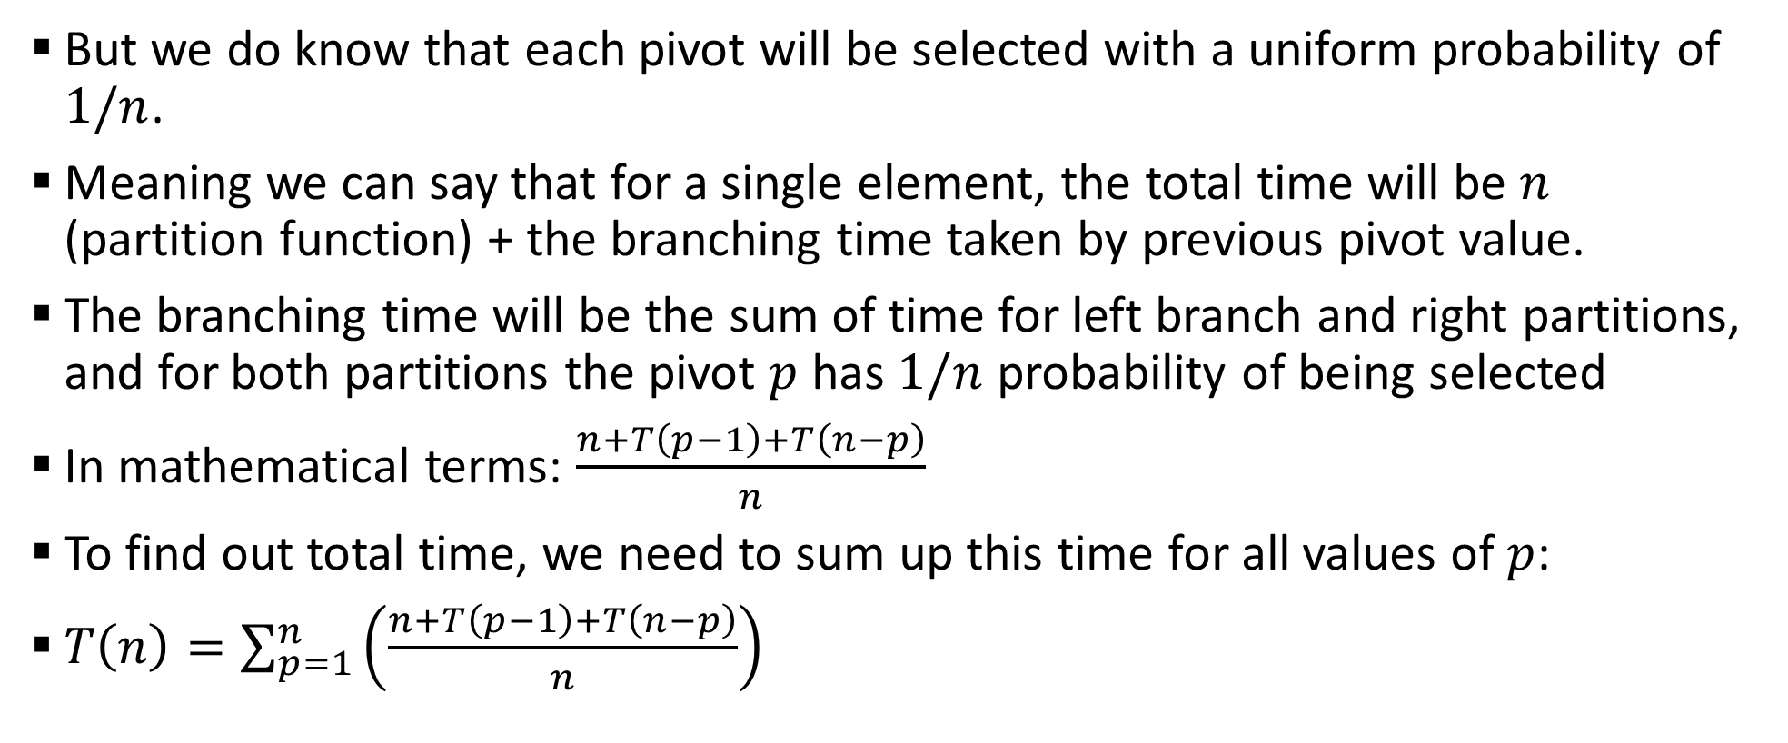
Sample 2
Complexity Analysis – Average case
But we do know that each pivot will be selected with a uniform probability of $1/n$.
Meaning we can say that for a single element, the total time will be $n$ (partition function) + the branching time taken by previous pivot value.
The branching time will be the sum of time for left branch and right partitions, and for both partitions the pivot $p$ has $1/n$ probability of being selected
In mathematical terms: $\frac{n+T\left(p−1\right)+T\left(n−p\right)}{n}$
To find out total time, we need to sum up this time for all values of $p$:
$T\left(n\right)=\sum_{p=1}^{n}{\left(\frac{n+T\left(p−1\right)+T\left(n−p\right)}{n}\right)}$
Notes:
Ref: CS502_Lecture14 - YouTube

Slide 19
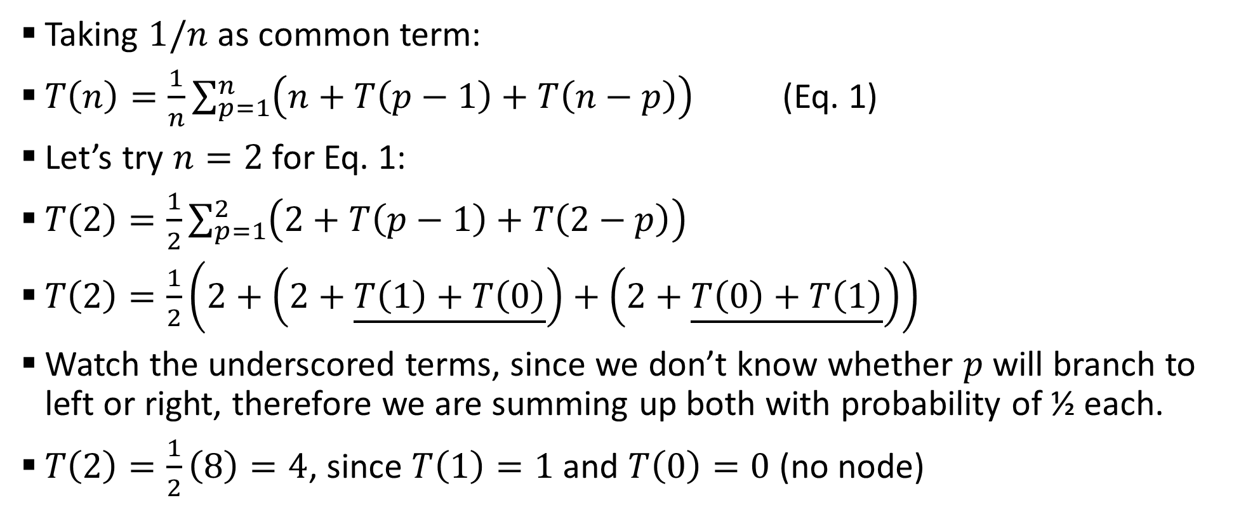
Sample 2
Complexity Analysis – Average case
Taking $1/n$ as common term:
$T\left(n\right)=\frac{1}{n}\sum_{p=1}^{n}{\left(n+T\left(p−1\right)+T\left(n−p\right)\right)}$ (Eq. 1)
Let’s try $n=2$ for Eq. 1:
$T\left(2\right)=\frac{1}{2}\sum_{p=1}^{2}{\left(2+T\left(p−1\right)+T\left(2−p\right)\right)}$
$T\left(2\right)=\frac{1}{2}\left(2+\left(2+\underline{T\left(1\right)+T\left(0\right)}\right)+\left(2+\underline{T\left(0\right)+T\left(1\right)}\right)\right)$
Watch the underscored terms, since we don’t know whether $p$ will branch to left or right, therefore we are summing up both with probability of ½ each.
$T\left(2\right)=\frac{1}{2}\left(8\right)=4$, since $T\left(1\right)=1$ and $T\left(0\right)=0$ (no node)

Slide 20
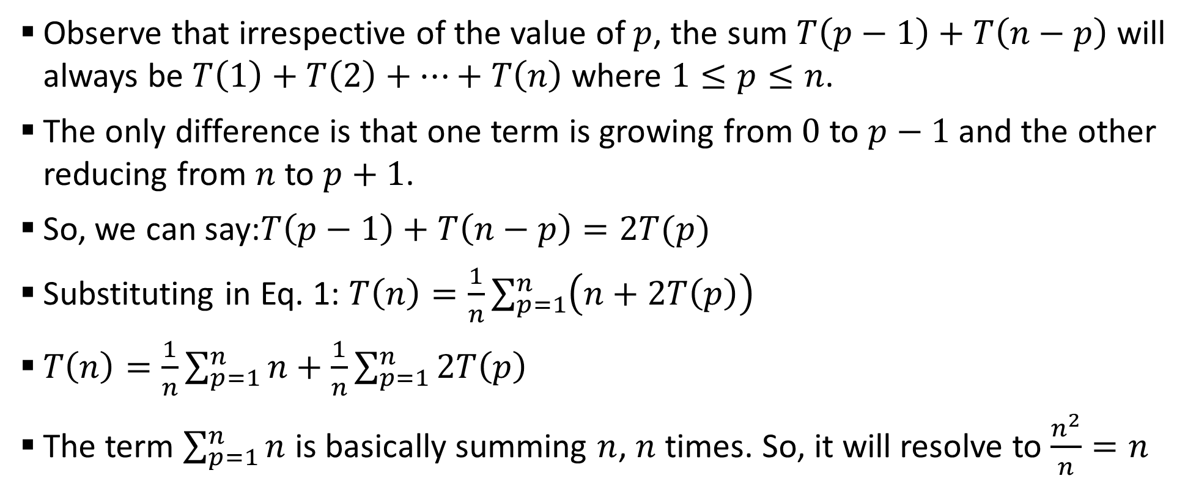
Sample 2
Complexity Analysis – Average case
Observe that irrespective of the value of $p$, the sum $T\left(p−1\right)+T\left(n−p\right)$ will always be $T\left(1\right)+T\left(2\right)+…+T\left(n\right)$ where $1≤p≤n$.
The only difference is that one term is growing from $0$ to $p−1$ and the other reducing from $n$ to $p+1$.
So, we can say:$T\left(p−1\right)+T\left(n−p\right)=2T(p)$
Substituting in Eq. 1: $T\left(n\right)=\frac{1}{n}\sum_{p=1}^{n}{\left(n+2T\left(p\right)\right)}$
$T\left(n\right)=\frac{1}{n}\sum_{p=1}^{n}{n}+\frac{1}{n}\sum_{p=1}^{n}{2T\left(p\right)}$
The term $\sum_{p=1}^{n}{n}$ is basically summing $n$, $n$ times. So, it will resolve to $\frac{n^{2}}{n}=n$

Slide 21
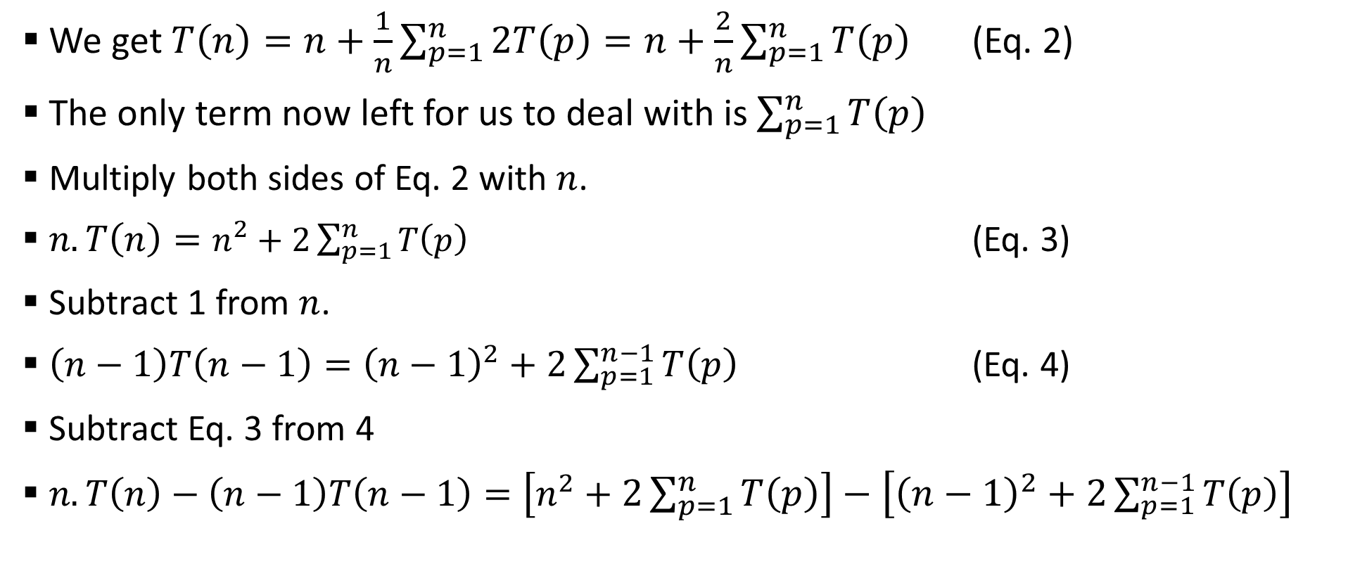
Sample 2
Complexity Analysis – Average case
We get $T\left(n\right)=n+\frac{1}{n}\sum_{p=1}^{n}{2T\left(p\right)}=n+\frac{2}{n}\sum_{p=1}^{n}{T\left(p\right)}$ (Eq. 2)
The only term now left for us to deal with is $\sum_{p=1}^{n}{T\left(p\right)}$
Multiply both sides of Eq. 2 with $n$.
$n.T\left(n\right)=n^{2}+2\sum_{p=1}^{n}{T\left(p\right)}$ (Eq. 3)
Subtract 1 from $n$.
$\left(n−1\right)T\left(n−1\right)={\left(n−1\right)}^{2}+2\sum_{p=1}^{n−1}{T\left(p\right)}$ (Eq. 4)
Subtract Eq. 3 from 4
$n.T\left(n\right)−\left(n−1\right)T\left(n−1\right)=\left[n^{2}+2\sum_{p=1}^{n}{T\left(p\right)}\right]−\left[{\left(n−1\right)}^{2}+2\sum_{p=1}^{n−1}{T\left(p\right)}\right]$

Slide 22
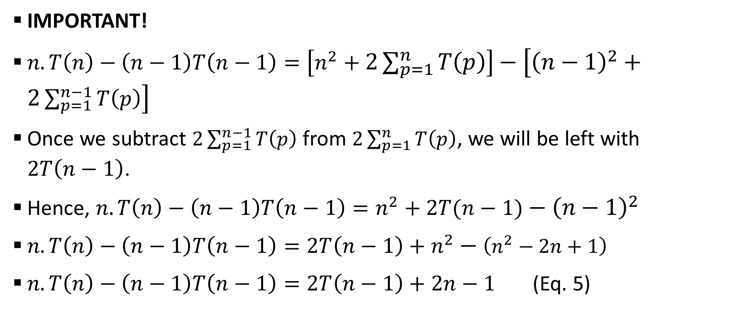
Sample 2
Complexity Analysis – Average case
IMPORTANT!
$n.T\left(n\right)−\left(n−1\right)T\left(n−1\right)=\left[n^{2}+2\sum_{p=1}^{n}{T\left(p\right)}\right]−\left[{\left(n−1\right)}^{2}+2\sum_{p=1}^{n−1}{T\left(p\right)}\right]$
Once we subtract $2\sum_{p=1}^{n−1}{T\left(p\right)}$ from $2\sum_{p=1}^{n}{T\left(p\right)}$, we will be left with $2T\left(n−1\right)$.
Hence, $n.T\left(n\right)−\left(n−1\right)T\left(n−1\right)=n^{2}+2T(n−1)−{\left(n−1\right)}^{2}$
$n.T\left(n\right)−\left(n−1\right)T\left(n−1\right)=2T\left(n−1\right)+n^{2}−\left(n^{2}−2n+1\right)$
$n.T\left(n\right)−\left(n−1\right)T\left(n−1\right)=2T\left(n−1\right)+2n−1$ (Eq. 5)

Slide 23
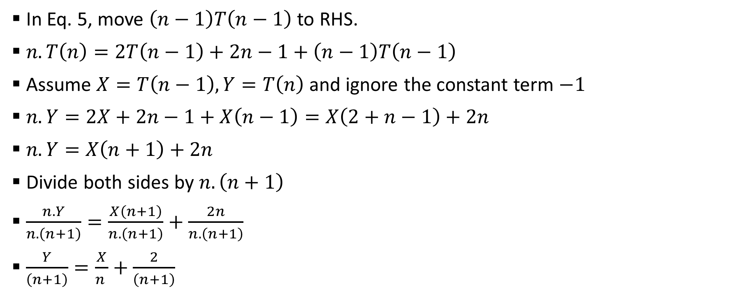
Sample 2
Complexity Analysis – Average case
In Eq. 5, move $\left(n−1\right)T\left(n−1\right)$ to RHS.
$n.T\left(n\right)=2T\left(n−1\right)+2n−1+\left(n−1\right)T\left(n−1\right)$
Assume $X=T\left(n−1\right),Y=T\left(n\right)$ and ignore the constant term $−1$
$n.Y=2X+2n−1+X\left(n−1\right)=X\left(2+n−1\right)+2n$
$n.Y=X\left(n+1\right)+2n$
Divide both sides by $n.\left(n+1\right)$
$\frac{n.Y}{n.\left(n+1\right)}=\frac{X\left(n+1\right)}{n.\left(n+1\right)}+\frac{2n}{n.\left(n+1\right)}$
$\frac{Y}{\left(n+1\right)}=\frac{X}{n }+\frac{2}{\left(n+1\right)}$

Slide 24
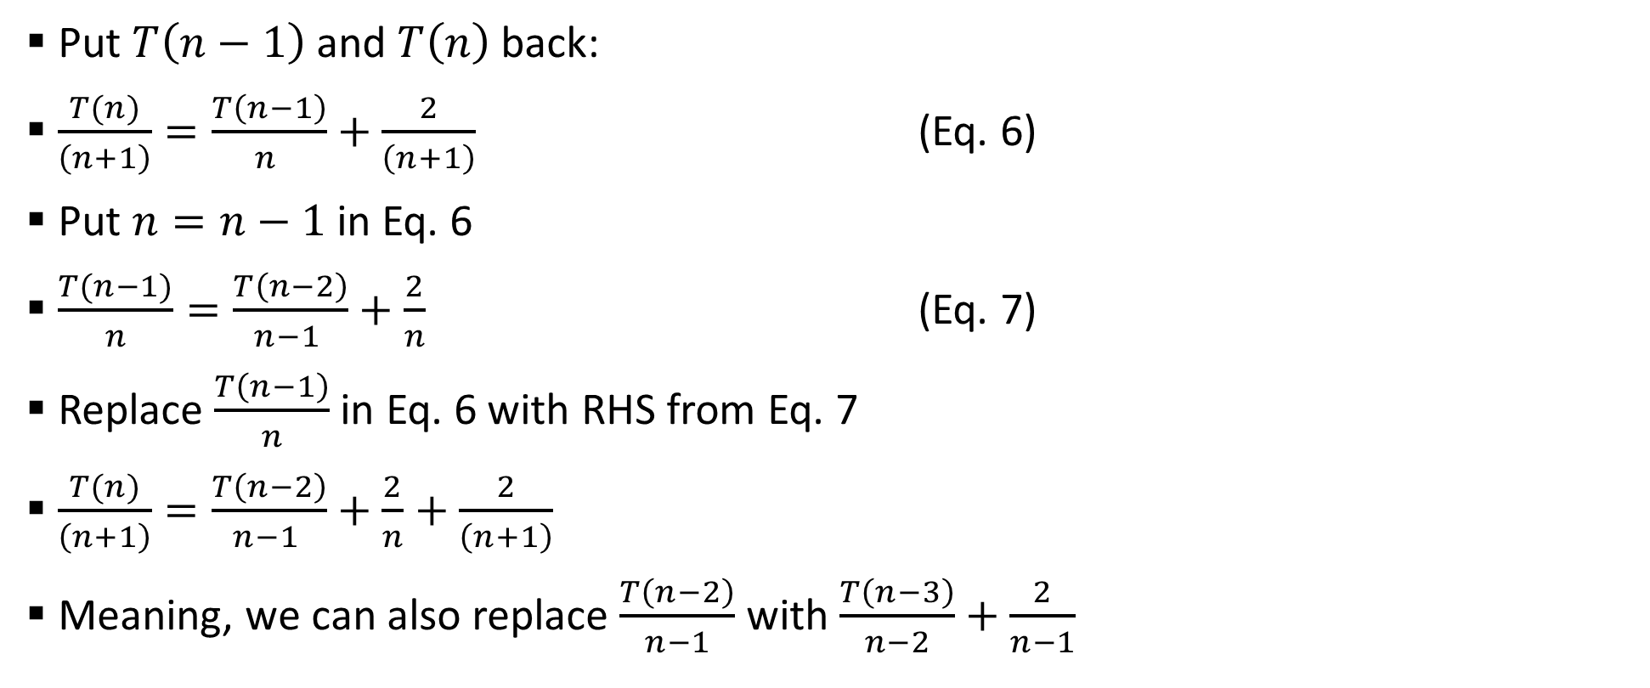
Sample 2
Complexity Analysis – Average case
Put $T\left(n−1\right)$ and $T\left(n\right)$ back:
$\frac{T(n)}{\left(n+1\right)}=\frac{T\left(n−1\right)}{n }+\frac{2}{\left(n+1\right)}$ (Eq. 6)
Put $n=n−1$ in Eq. 6
$\frac{T(n−1)}{n}=\frac{T\left(n−2\right)}{n−1 }+\frac{2}{n}$ (Eq. 7)
Replace $\frac{T\left(n−1\right)}{n}$ in Eq. 6 with RHS from Eq. 7
$\frac{T(n)}{\left(n+1\right)}=\frac{T\left(n−2\right)}{n−1 }+\frac{2}{n}+\frac{2}{\left(n+1\right)}$
Meaning, we can also replace $\frac{T\left(n−2\right)}{n−1}$ with $\frac{T\left(n−3\right)}{n−2}+\frac{2}{n−1}$

Slide 25
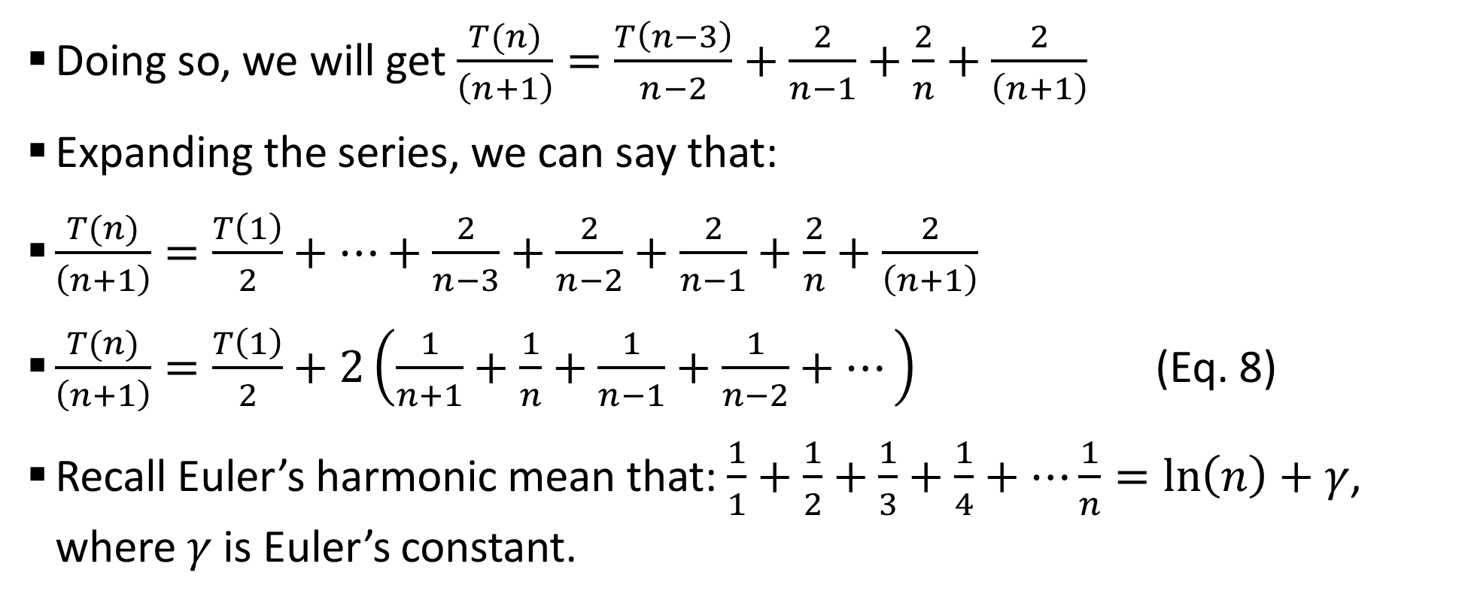
Sample 2
Complexity Analysis – Average case
Doing so, we will get $\frac{T(n)}{\left(n+1\right)}=\frac{T\left(n−3\right)}{n−2}+\frac{2}{n−1}+\frac{2}{n}+\frac{2}{\left(n+1\right)}$
Expanding the series, we can say that:
$\frac{T(n)}{\left(n+1\right)}=\frac{T\left(1\right)}{2}+…+\frac{2}{n−3}+\frac{2}{n−2}+\frac{2}{n−1}+\frac{2}{n}+\frac{2}{\left(n+1\right)}$
$\frac{T(n)}{\left(n+1\right)}=\frac{T\left(1\right)}{2}+2\left(\frac{1}{n+1}+\frac{1}{n}+\frac{1}{n−1}+\frac{1}{n−2}+…\right)$ (Eq. 8)
Recall Euler’s harmonic mean that: $\frac{1}{1}+\frac{1}{2}+\frac{1}{3}+\frac{1}{4}+…\frac{1}{n}=\ln\left(n\right)+γ$, where $γ$ is Euler’s constant.

Slide 26
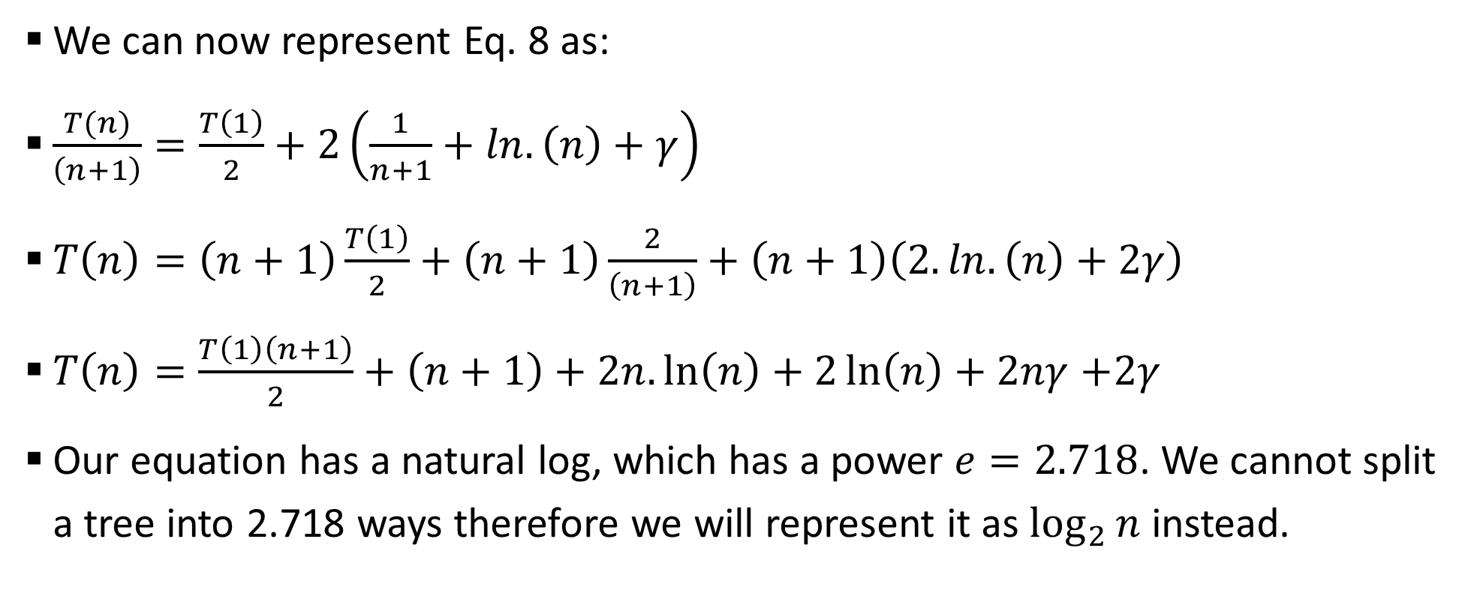
Sample 2
Complexity Analysis – Average case
We can now represent Eq. 8 as:
$\frac{T(n)}{\left(n+1\right)}=\frac{T\left(1\right)}{2}+2\left(\frac{1}{n+1}+ln.\left(n\right)+γ\right)$
$T\left(n\right)=\left(n+1\right)\frac{T\left(1\right)}{2}+\left(n+1\right)\frac{2}{\left(n+1\right)}+\left(n+1\right)\left(2.ln.\left(n\right)+2γ\right)$
$T\left(n\right)=\frac{T\left(1\right)\left(n+1\right)}{2}+\left(n+1\right)+2n.\ln\left(n\right)+2\ln\left(n\right)+2nγ$ $+2γ$
Our equation has a natural log, which has a power $e=2.718$. We cannot split a tree into 2.718 ways therefore we will represent it as $\log_{2}{n}$ instead.

Slide 27
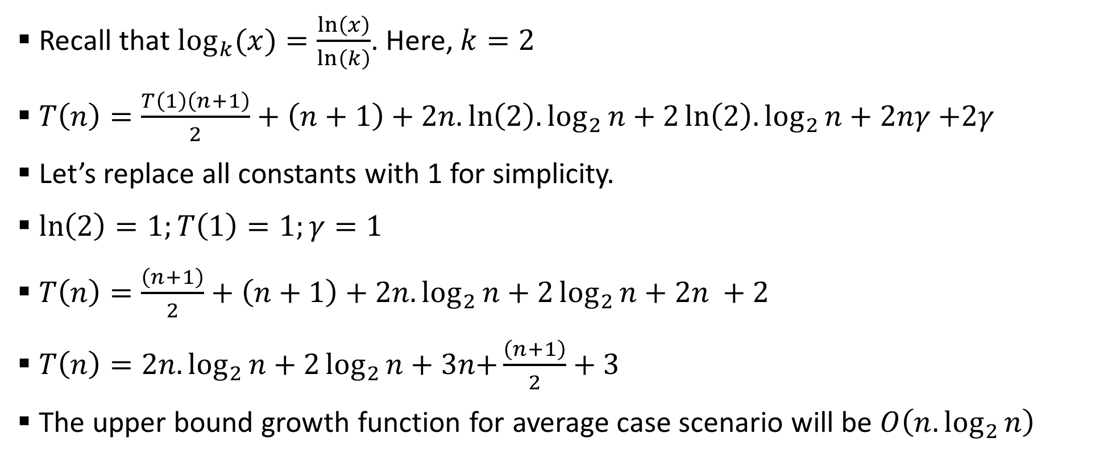
Sample 2
Complexity Analysis – Average case
Recall that $\log_{k}{(x)=\frac{\ln\left(x\right)}{\ln\left(k\right)}}$. Here, $k=2$
$T\left(n\right)=\frac{T\left(1\right)\left(n+1\right)}{2}+\left(n+1\right)+2n.\ln\left(2\right).\log_{2}{n}+2\ln\left(2\right).\log_{2}{n}+2nγ$ $+2γ$
Let’s replace all constants with 1 for simplicity.
$\ln\left(2\right)=1;T\left(1\right)=1;γ=1$
$T\left(n\right)=\frac{\left(n+1\right)}{2}+\left(n+1\right)+2n.\log_{2}{n}+2\log_{2}{n}+2n +2$
$T\left(n\right)=2n.\log_{2}{n}+2\log_{2}{n}+3n\text{+}\frac{\left(n+1\right)}{2}+3$
The upper bound growth function for average case scenario will be $O\left(n.\log_{2}{n}\right)$

Slide 28
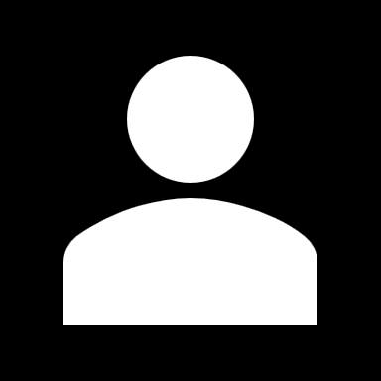
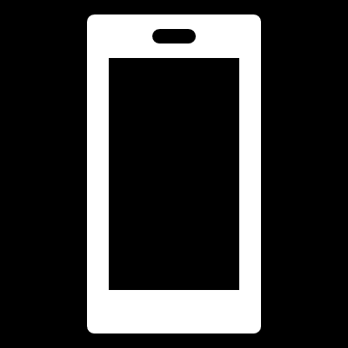
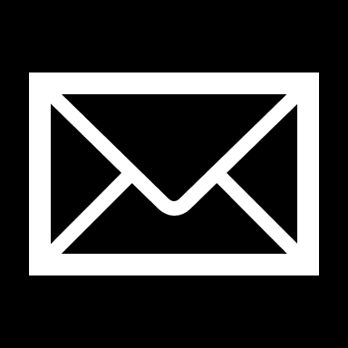
THANK YOU
Owais Hussain
+92 345-3174270
owais.hussain@kiet.edu.pk
https://www.researchgate.net/profile/Owais-Hussain-3

